Slide 1
SYST36367 Capstone Project Requirements & Design NOTL(Niagara On The Lake) Hydro
Presented by: Team Sprinters

Slide 2
Agenda
Team Introduction
Client & Project Introduction
Project Overview
Project Demonstration
Transition Plan

Slide 3




Team Introduction

Slide 4

Client & Project Introduction
Niagara on the Lake Hydro Inc. is the municipality of Niagara-on-the-electric Lake's utility, serving around 10,000 consumers.
Goal : Minimize greenhouse gas emissions and slow the effects of climate change, the corporation aspires to be an industry leader.
Niagara on the Lake Hydro is actively taking steps to minimize its own internal operating emissions, and now wants to help its customers measure, analyze, compare, and ultimately reduce their aggregate carbon footprints.

Slide 5
Project
Goal: To build an effective web application tool that allow customers to track their carbon emissions over time and encourage them to reduce their emissions.

Slide 6
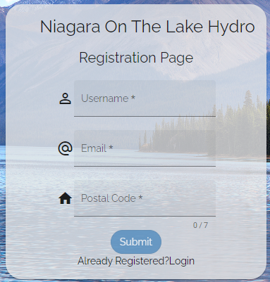
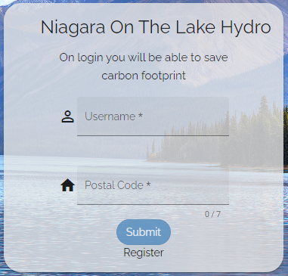
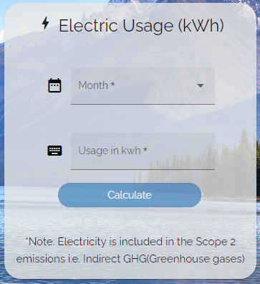
Project Highlights

Slide 7



Development Stack
Frontend
Backend
Deployment

Slide 8
Thank You!

